Slide 1
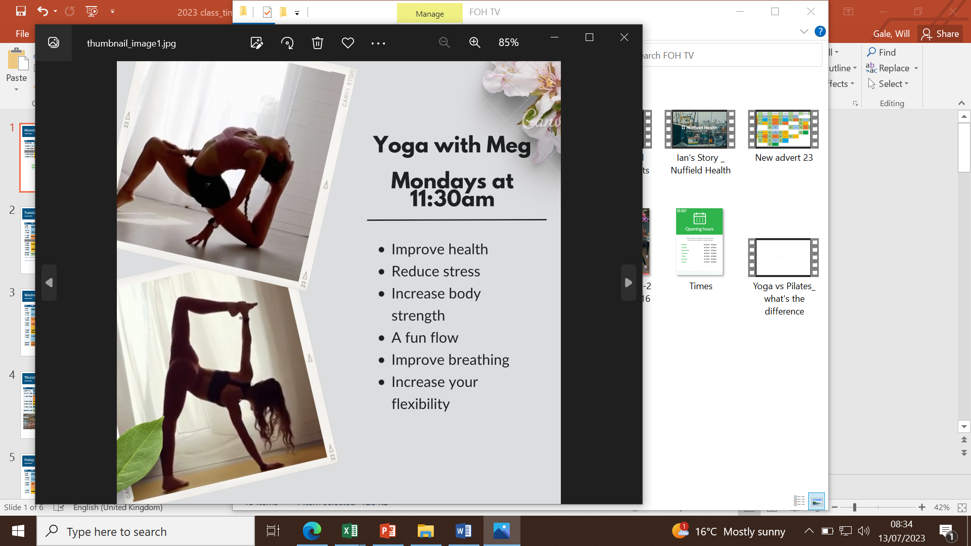

Monday
Class timetable.
Time | Class | Location | Instructor
6:45-7:30 | CYCLE (Requires booking) Limited spaces, book at reception | Sport hall | David
10:30-11:15 | FIT FUNCTION | Sport hall | Gym team
11:30-12:30 | YOGA | Sport hall | Megan
17:30-18:00 | LBT | Sport hall | Gym team
18:00-19:00 | YOGALATES (Requires booking) (NEW) | Sport hall | Maxine S
18:30-19:00 | CORE BLAST (NEW) | Gym Floor | Gym Team
19:15-20:00 | AQUA (Requires booking) | Pool | Adam
20:00 – 22:00 | Badminton Matches (Not every week) | Sports Hall | External

Slide 2
Tuesday
Class timetable.
Time | Class | Location | Instructor
6:30-7:15 | BOOTCAMP | Sport hall | David
10:15-11:00 | AQUA (Requires booking) | Pool | Gym team
11:15-12:15 | TAI CHI | Sport hall | Jessica
17:30-18:00 | TABATA | Sport hall | Gym team
18:00-19:00 | YOGA | Sport hall | Maxine S.
19:05-19:35 | CYCLE (Requires booking) Limited spaces, book at reception | Sport hall | Brigitta
20-00- 21:30 | Korfball | Sport hall | External group
Ask at reception to find out more about Korfball
**This is an external group and not an activity included in membership**

Slide 3
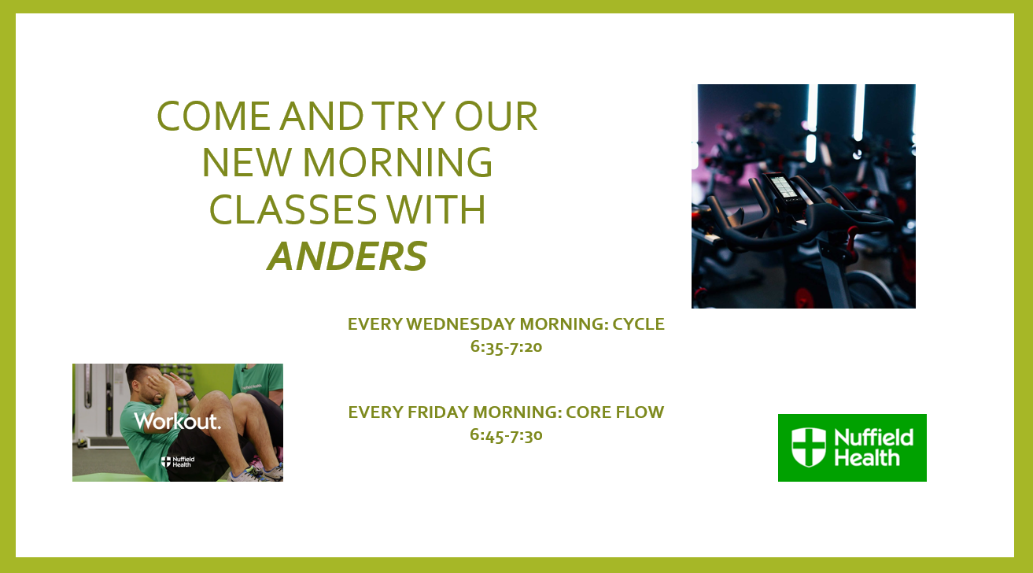
Wednesday
Class timetable.
Time | Class | Location | Instructor
6:35-7:20 | CYCLE (Requires booking) Limited spaces, book at reception | Sport hall | Anders
10:30-11:15 | FIT FUNCTION | Sport hall | Gym team
11:30-12:30 | TAI CHI | Sport hall | Jessica
12:30-13:00 | 10-10-10 (Cardio-Weights-Core) | Sport hall | Gym team
17:30-18:15 | BOOTCAMP | Sport hall | Wayne
18:15-19:15 | FLOW AND STRONG YOGA (Requires booking) (NEW) | Sport hall | Isabella
18:30-19:15 | AQUA HITT (NEW) | Pool | Wayne
18:30-19:00 | CORE BLAST (NEW) | Gym Floor | Gym team
20:00-22:00 | MEMBERS BADMINTON | Sport hall

Slide 4
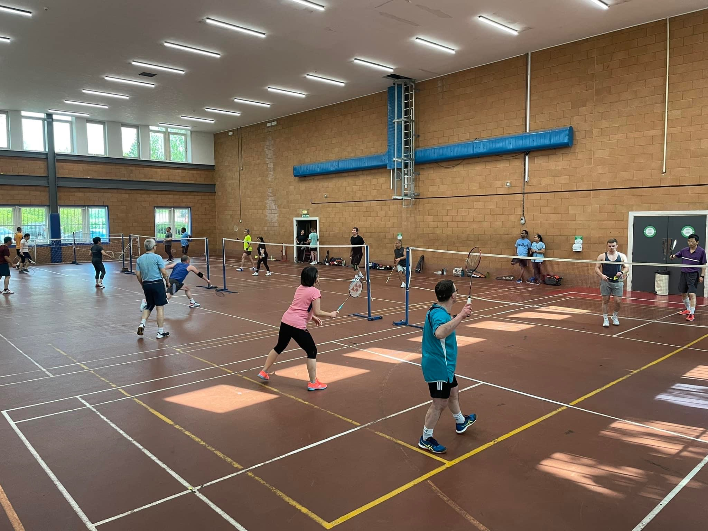
Thursday
Class timetable.
Time | Class | Location | Instructor
6:30-7:15 | BOOTCAMP | Sport hall | Dave
10:15-11:00 | AQUA | Pool | Gym team
11:30-12:30 | PILATES (Requires booking) | Sport hall | Jenny
17:30-18:00 | KETTLEBELL HIIT | Sport hall | Gym team
18:00-18:45 | DANCE FIT (NEW) | Sport hall | Eve
20-00- 21:30 | Club MK badminton | Sport hall | External group
Members badminton
All levels welcome
Wednesday
20:00 – 22:00
Saturday
14:00 – 16:00

Slide 5

Friday
Class timetable.
Time | Class | Location | Instructor
6:45-7:30 | CORE FLOW | Sport hall | Anders
10:30-11:15 | FIT FUNCTION | Sport hall | Gym team
11:25-12:25 | PILATES & STRETCH (Requires booking) | Sport hall | Jenny
12:30-13:00 | LBT | Sport hall | Gym team
17:30-18:15 | CYCLE | Sports hall | Wayne
17:30-18:00 | CORE BLAST | Squash Court | Gym team
18:20-19:05 | LATINO DANCE (NEW) | Sport hall | Eve

Slide 6
Weekends
Pilates on a Saturday – For those who are new to Pilates we recommend attending the 2nd session at 11:25. This sessions is welcome to all abilities but will be structured to offer more advice for beginners.
Class timetable.
Saturday Time | Class | Location | Instructor
09:10-09:40 | SPIN 30 (Requires booking) (NEW) Limited spaces, book at reception1 class per member | Sport hall | Dewi
09:45-10:15 | SPIN 30 (Requires booking) (NEW) Limited spaces, book at reception. 1 class per member | Sport hall | Dewi
10:20-11:20 | PILATES (Requires booking) | Sport hall | Jenny
11:20 – 12:05 | NEW PILATES (Requires booking) | Sport hall | Jenny
12:30 – 14:00 | MEMBERS WALKING FOOTBALL (book at reception) | Sports Hall
14:00-17:00 | MEMBERS BADMINTON | Sport hall
Sunday Time | Class | Location | Instructor
9:00-9:45 | CYCLE (Requires booking) Limited spaces, book at reception | Sport hall | Anders/ Gym team
10:00-11:00 | STRICTLY COME BALLROOM (NEW) | Sports Hall | Eve
14:00 – 17:00 | Shenley Archers | Sports Hall | External

